Slide 1
Plan: show how replicate Cohen’s examples

Slide 2
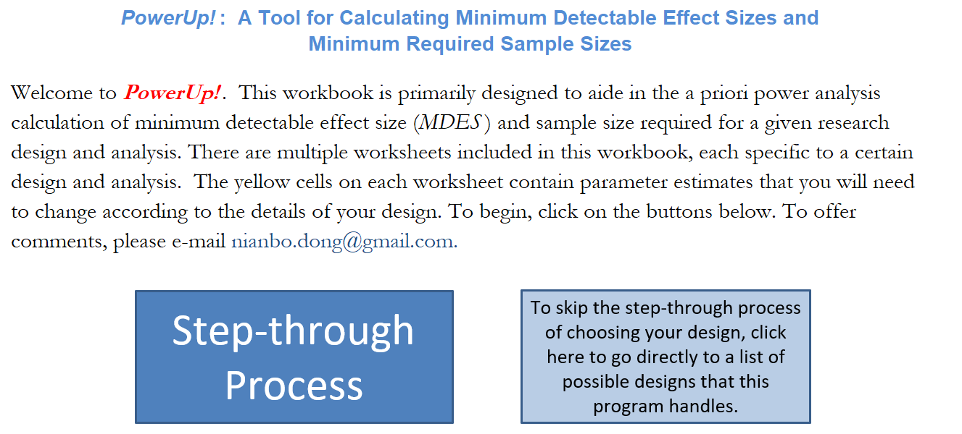

Slide 3
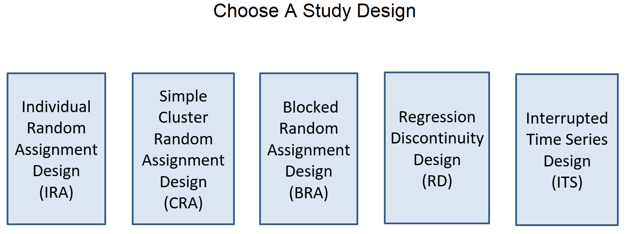

Slide 4
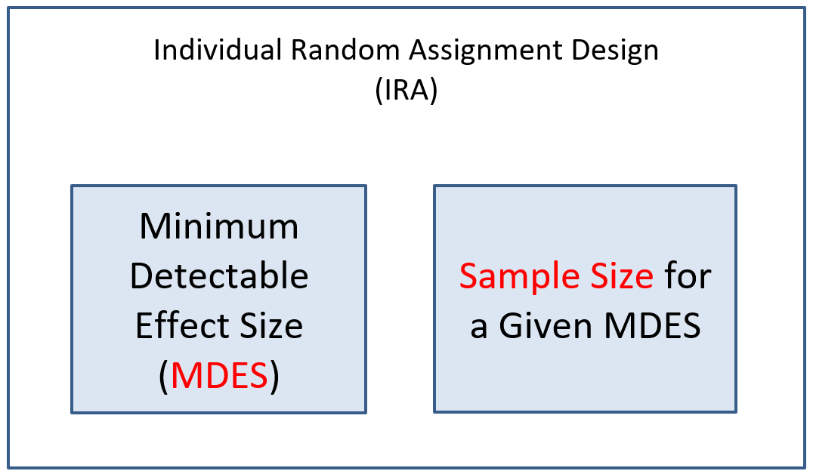

Slide 5
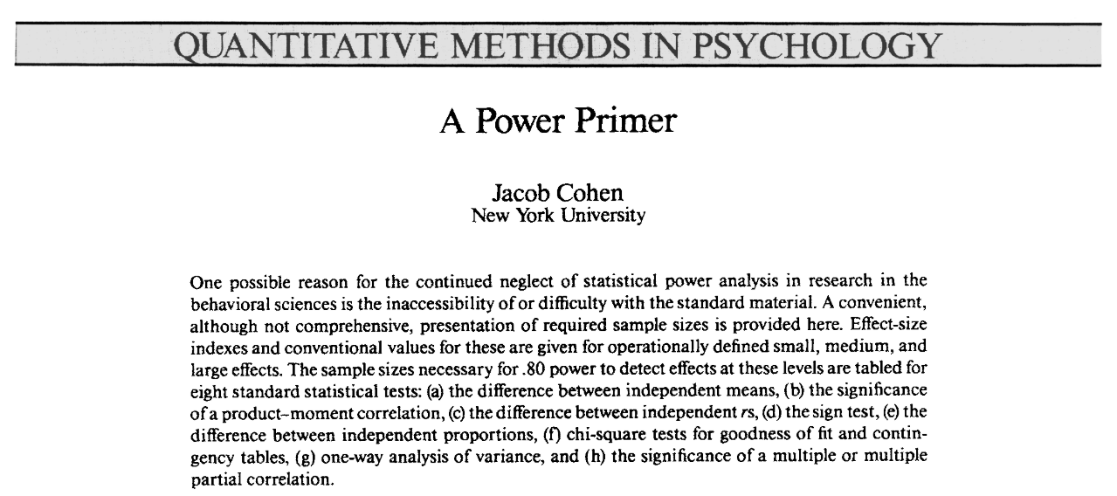

Slide 6
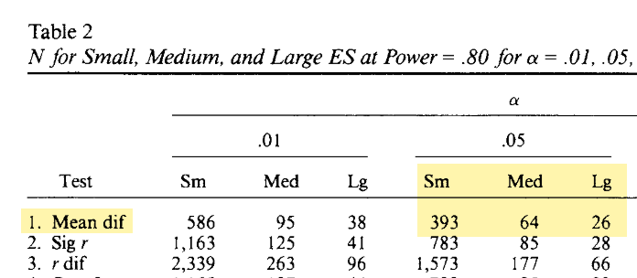
Note: N per group

Slide 7
Model 1.0: Sample Size Calculator for Individual Random Assignment Designs (IRA)—Completely Randomized Controlled Trials
Assumptions |  | Comments
MRES = MDES | 0.20 | Minimum Relevant Effect Size = Minimum Detectable Effect Size
Alpha Level (α) | 0.05 | Probability of a Type I error
Two-tailed or One-tailed Test? | 2
Power (1-β) | 0.80 | Statistical power (1-probability of a Type II error)
P | 0.50 | Proportion of the sample randomized to treatment: n_{T} / (n_{T} + n_{C})
R² | 0.00 | Percent of variance in the outcome explained by covariates
k* | 0 | The number of covariates used
N (Sample Size) | 787 | The number of individuals needed for the given MDES.

Slide 8
Model 1.0: Sample Size Calculator for Individual Random Assignment Designs (IRA)—Completely Randomized Controlled Trials
Assumptions |  | Comments
MRES = MDES | 0.50 | Minimum Relevant Effect Size = Minimum Detectable Effect Size
Alpha Level (α) | 0.05 | Probability of a Type I error
Two-tailed or One-tailed Test? | 2
Power (1-β) | 0.80 | Statistical power (1-probability of a Type II error)
P | 0.50 | Proportion of the sample randomized to treatment: n_{T} / (n_{T} + n_{C})
R² | 0.00 | Percent of variance in the outcome explained by covariates
k* | 0 | The number of covariates used
N (Sample Size) | 128 | The number of individuals needed for the given MDES.

Slide 9
Assumptions |  | Comments
MRES = MDES | 0.20 | MRES = MDES
Alpha Level (α) | 0.05 | Probability of a Type I error
Two-tailed or One-tailed Test? | 2
Power (1-β) | 0.80 | Statistical power (1-probability of a Type II error)
Rho (ICC) | 0.05 | Proportion of variance in outcome that is between clusters
n (Average Cluster Size) | 20 | Mean number of Level 1 units per Level 2 cluster (harmonic mean recommended)
Sample Retention Rate: Level 2 units | 80% | Proportion of Level 2 units retained in analysis sample
Sample Retention Rate: Level 1 units | 80% | Proportion of Level 1 units retained in analysis sample
P | 0.500 | Proportion of sample randomized to treatment: J_{T} / (J_{T} + J_{C})
R₁² | 0.500 | Proportion of variance in Level 1 outcome explained by Level 1 covariates
R₂² | 0.500 | Proportion of variance in Level 2 outcome explained by Level 2 covariates
g* | 5 | Number of Level 2 covariates
Priori-J (Sample Size [Clusters #]) | 57
Priori-M (Multiplier) | 2.88 | Computed from Priori-T1 and Priori-T2
M (Multiplier) | 2.88 | Automatically computed
J (Sample Size [Clusters #]) | 57 | Number of clusters needed for given MRES

Slide 10
Assumptions |  | Comments
MRES = MDES | 0.20 | MRES = MDES
Alpha Level (α) | 0.05 | Probability of a Type I error
Two-tailed or One-tailed Test? | 2
Power (1-β) | 0.80 | Statistical power (1-probability of a Type II error)
Rho (ICC) | 0.05 | Proportion of variance in outcome that is between clusters
n (Average Cluster Size) | 20 | Mean number of Level 1 units per Level 2 cluster (harmonic mean recommended)
Sample Retention Rate: Level 2 units | 80% | Proportion of Level 2 units retained in analysis sample
Sample Retention Rate: Level 1 units | 80% | Proportion of Level 1 units retained in analysis sample
P | 0.500 | Proportion of sample randomized to treatment: J_{T} / (J_{T} + J_{C})
R₁² | 0.000 | Proportion of variance in Level 1 outcome explained by Level 1 covariates
R₂² | 0.000 | Proportion of variance in Level 2 outcome explained by Level 2 covariates
g* | 5 | Number of Level 2 covariates
Priori-J (Sample Size [Clusters #]) | 110
Priori-M (Multiplier) | 2.84 | Computed from Priori-T1 and Priori-T2
M (Multiplier) | 2.84 | Automatically computed
J (Sample Size [Clusters #]) | 110 | Number of clusters needed for given MRES

